Slide 1
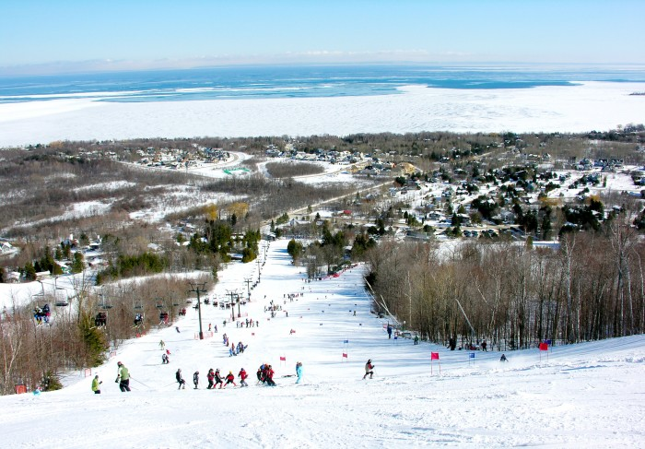
GDHL 2014

Slide 2
Thank you to our sponsors

Slide 3
Thank you to our sponsors

Slide 4
Thank you to our sponsors

Slide 5
Thank you to our sponsors

Slide 6
Thank you to our sponsors

Slide 7
Thank you to our sponsors

Slide 8
Thank you to our sponsors

Slide 9
Thank you to our sponsors

Slide 10
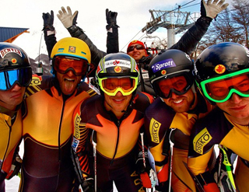
A bit of housekeeping…
Some noteworthy accomplishments…

Slide 11
Some noteworthy accomplishments
115 skiers racing in the GDHL (+108 vs 2012/2013, +95 vs 2011/2012)
13 racers under the age of 30
A bit less swag for individual GDHL racers, but a lot more contribution to racing at the Club generally, including
Donation of a basket of racing opportunities worth almost $1,000 to the Athletic Fundraiser
Special purchase of a supply of gates for use in the adult gate training program
Special commitment to fund the purchase of computer equipment for use in the finish huts, which will help with a planned live timing project

Slide 12
Some noteworthy accomplishments
Budget contribution of $6,000 to general racing expenses & $2,500 to general administrative expenses at the Club
Big increases in Snow School programs over last year, including
50% increase in Christmas camp registrations
100% increase in adult technical program registrations
Adult gate training programs sold out with a waiting list
Friday training registrations increased by almost 50%

Slide 13
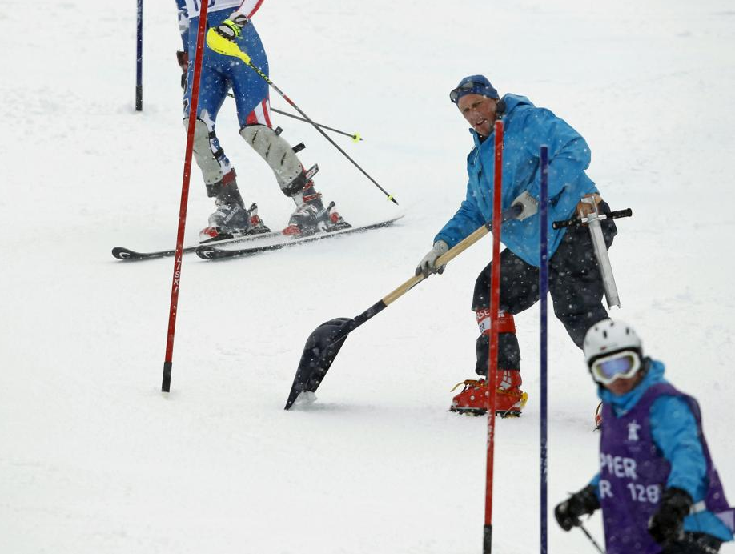
A bit of housekeeping…

Slide 14
Housekeeping
Please pay $10 per wine bottle to the bar for corkage
Please complete the 2 short surveys we will be distributing, and return them during the evening
Please return bibs to Kylie in the race office, or you will be charged!

Slide 15
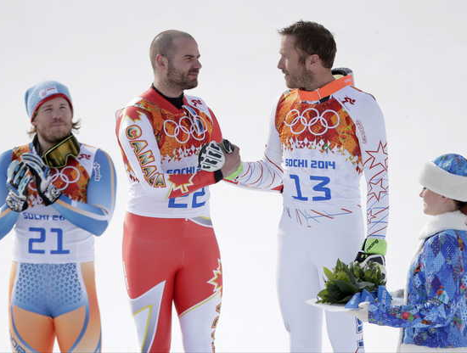
The results

Slide 16
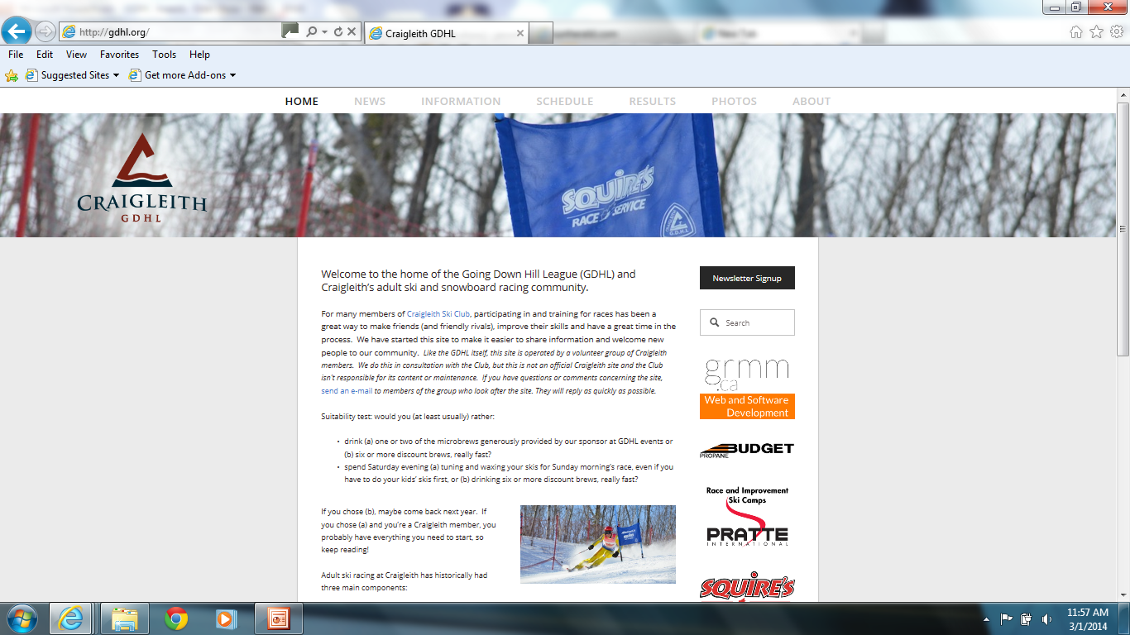
gdhl.org

Slide 17
The results

Slide 18
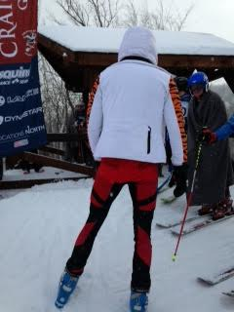

Slide 20
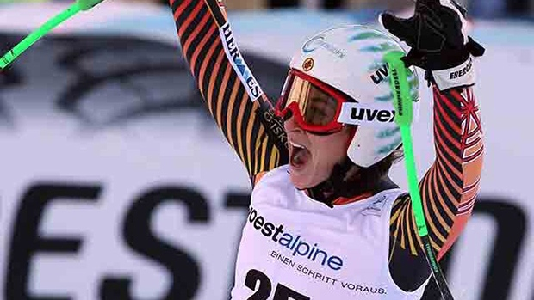
Most Improved (Women)

Slide 21
Most Improved (Women)
3rd Elspeth Gaukrodger Rank 100, Finish 95, 0.95 fraction, 95 LY
2nd Daina Dunlop Rank 93, Finish 77, 0.83 fraction, 88 LY
1st Leslie Morgan Rank 60, Finish 45, 0.75 fraction, 53 LY

Slide 22
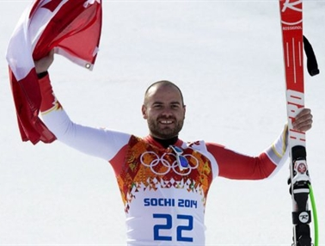
Most Improved (Men)

Slide 23
Most Improved (Men)
3rd Brook Dyson Rank 33, Finish 20, 0.61 fraction, 30 LY
2nd Will Andrew Rank 69, Finish 39, 0.57 fraction, 64 LY
1st Jamie Coulter Rank 82, Finish 40, 0.49 fraction, 80 LY

Slide 24
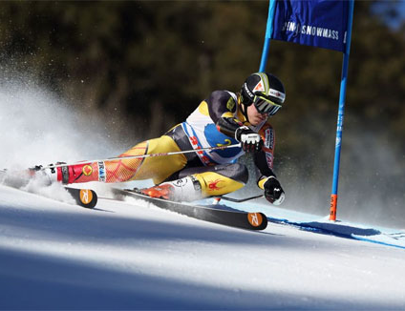
Top 3 (Men)

Slide 25
Top 3 (Men)
3rd Scott McLorie 455 pts
2nd Ian Malcolm 459 pts
1st Alec Libert 464 pts

Slide 26
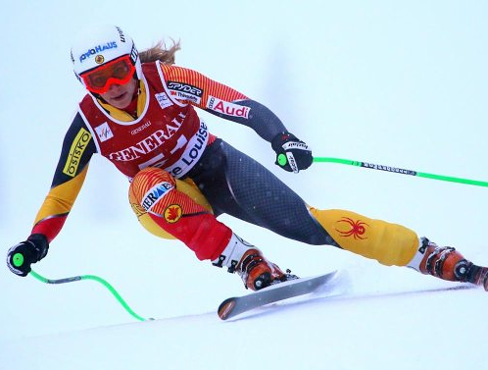
Top 3 (Women)

Slide 27
Top 3 (Women)
3rd Lisa Warll 315 pts
2nd Leslie Morgan 332 pts
1st Brittany Stainer 386 pts

Slide 28
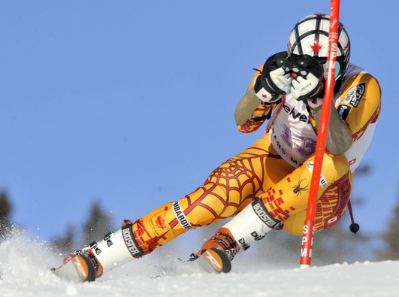
Over 50 (Men)

Slide 29
Over 50 (Men)
3rd Craig Shibley 417 pts
2nd Trent Winstone 430 pts
1st Jeff Sutherland 445 pts

Slide 30
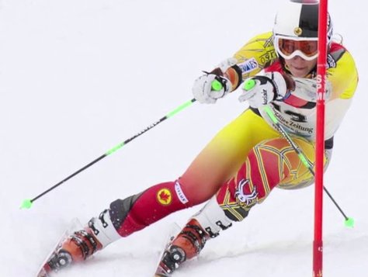
Over 50 (Women)

Slide 31
Over 50 (Women)
3rd Margaret Isberg 225 pts
2nd Daina Dunlop 239 pts
1st Tiana Boyman 247 pts

Slide 32
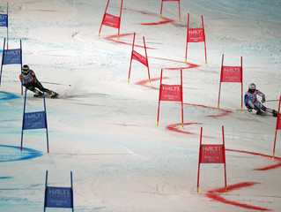
Individual Ranking

Slide 33
Individual Ranking
Place | Name | Points
1st | Libert, Alec | 464
2nd | Malcolm, Ian | 459
3rd | McLorie, Scott | 455
4th | Cavers, Greg | 453
5th | Macmillan, Doug | 452
6th | Sutherland, Jeff | 445
7th | Raymond, David | 443
8th | Jackson, Spencer | 441
8th | Jansons, Andrew | 441
10th | Jackson, Trevor | 440
11th | Ruffolo, Philip | 436
Place | Name | Points
12th | Rubes, Morgan | 434
13th | Winstone, Trent | 430
13th | Deeks, Doug | 430
15th | Jarvis, Douglas | 423
16th | Kappele, Ross | 417
16th | Shibley, Craig | 417
18th | Jansons, Alex | 410
19th | Pedlar, Patrick | 409
20th | Dyson, Brook | 406
20th | Dalton, Randy | 406
22nd | Courville, JF | 405

Slide 34
Individual Ranking
Place | Name | Points
23rd | Von Teichman, Matt | 402
24th | Blaylock, Glenn | 401
25th | Banfield, John | 398
26th | Latimer, Ian | 396
27th | Lavery, Richard | 395
28th | Stainer, Brittany | 386
29th | Burnes, Robert | 381
30th | Usher-Jones, Rich | 378
31st | Conacher, Bryce | 375
32nd | Gust, Kevin | 374
32nd | Patten, Jerry | 374
Place | Name | Points
34th | Caswell, Tom | 373
35th | Ardill, Peter | 370
36th | Craig, Jeff | 369
37th | Gin, Eric | 366
38th | Fregren, Chris | 362
39th | Andrew, Will | 355
40th | Coulter, James | 342
41st | McKay, Glenn | 341
42nd | Kilmer, Glenn | 337
42nd | Darlison, Byron | 337
44th | Morgan, Ted | 334

Slide 35
Individual Ranking
Place | Name | Points
45th | Morgan, Leslie | 332
45th | Mathers, James | 332
47th | Cassels, Robert | 331
48th | Jeanneault,Tristan | 325
49th | Clark, Chris | 322
50th | Barford, Mack | 318
51st | Warll, Lisa | 315
52nd | Shepherd, Bill | 311
53rd | Copp, Peter | 308
54th | Galligan, Patrick | 306
55th | Latimer, Sarah | 303
Place | Name | Points
56th | Bruce, Robert | 302
56th | Lash, David | 302
58th | Jarvis, Stephen | 300
58th | Statler, Ronald | 300
60th | McEachran, Duncan | 292
61st | Murakami, Ray | 285
62nd | Woodhouse, Paul | 280
62nd | Bigelow, Bill | 280
64th | Hillock, Kevin | 279
65th | Reidl, Mark | 274
66th | McMullen, Brad | 270

Slide 36
Individual Ranking
Place | Name | Points
67th | Gailits, Stephen | 261
68th | Lapas, Rick | 259
69th | Baran, David | 254
69th | Craig, Dougie | 254
71st | Copp, James | 251
72nd | Clark, Stephanie | 248
72nd | Shaw, Alan | 248
74th | Boyman, Tiana | 247
74th | Struthers, Ian | 247
76th | Thompson, Michael Anthony | 244
77th | Dunlop, Daina | 239
Place | Name | Points
78th | Worndl, Katie | 236
78th | Finlay, Warren | 236
80th | Isberg, Margaret | 225
80th | Norman, John | 225
82nd | Ferguson, John | 224
83rd | Smith, Gordon | 215
84th | McAdam, Robert | 213
85th | Lute, Tim | 209
85th | Riopelle, Mary | 209
87th | Beallor, Dean | 206
88th | Arthur, David | 205
89th | Arthur, Mark | 199

Slide 37
Individual Ranking
Place | Name | Points
90th | MacDonald, Dave | 193
91st | Sproule, Brad | 192
92nd | Stein, Gordon | 191
93rd | Nelson, Mansell | 188
94th | Mintz, Shayne | 187
95th | Gaukrodger, Elspeth | 183
95th | Gomes, Vern | 183
97th | Henschel, Paul | 182
98th | Hayhurst, George | 179
99th | Athey, Brian | 178
100th | Harrison, Craig | 176
101st | Sculthorpe, David | 167
102nd | McKillop, Tory | 156
Place | Name | Points
102nd | Forsyth, Morley | 156
104th | Von Schroeter, Alexandra | 153
105th | Spragge, Dave | 148
106th | Galligan, Tom | 142
107th | Waite, Cynthia | 138
108th | Hayworth, Glenn | 137
109th | Shea, Robin | 136
110th | Mathers, Anne | 133
111th | Wood, Grant | 127
112th | Davenport, Doreen | 122
113th | Callow, Robert | 116
114th | Gragtmans, Ian | 112
115th | Nogas, Kathy | 72

Slide 38
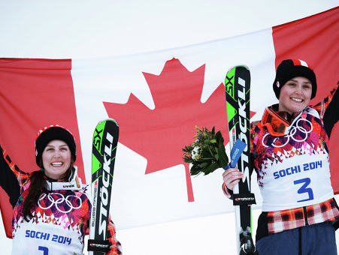
A few more fun statistics…

Slide 39
Best Husband & Wife Total Score
4th Glenn Kilmer & Tory McKillop 493 pts
3rd Byron Darlison & Daina Dunlop 576 pts
2nd Ted & Leslie Morgan 666 pts
1st Doug McMillan & Lisa Warll 767 pts

Slide 40
Best Parent & Child Total Score
4th Kevin Gust & Bob Callow 490 pts
3rd Chris & Stephanie Clark 570 pts
2nd Ian & Sarah Latimer 699 pts
1st Doug & Steve Jarvis 723 pts

Slide 41
Team Ranking

Slide 42
Team Ranking
10th Birches 2,811 pts
9th Comet 2,812 pts
8th Pen 2,884 pts
7th Big John 2,891 pts
6th Partridge 2,902 pts

Slide 43
Team Ranking
5th Funnel 2,940 pts
4th National 2,959 pts
3rd Venture 2,978 pts
2nd Millennium 3,023 pts
1st Landslide 3,300 pts

Slide 44
Team Ranking
10th Birches 2,811 pts
9th Comet 2,812 pts
8th Pen 2,884 pts
7th Big John 2,891 pts
6th Partridge 2,902 pts
5th Funnel 2,940 pts
4th National 2,959 pts
3rd Venture 2,978 pts
2nd Millennium 3,023 pts
1st Landslide 3,300 pts

Slide 45
3rd VENTURE 2,978 pts
2nd MILLENNIUM
3,023 pts
1st LANDSLIDE
3,300 pts
Arthur, David 205pts
Barford, Mack 318pts
Dalton, Randy 406pts
Darlison, Byron 337pts
Finlay, Warren 236pts
Fregren, Chris 363pts
MacMillan, Doug 452pts
Mathers, James 332pts
Sproule, Brad 192pts
Waite, Cynthia 138pts
Athey, Brian 178pts
Caswell, Tom 373pts
Henschel, Paul 182pts
Kappele, Ross 417pts
Lapas, Rick 259pts
Malcolm, Ian 459pts
Mintz, Shane 187pts
Norman, John 225pts
Raymond, Dave 443pts
Statler, Ronald 300pts
Clark, Stephanie 248pts
Coulter, James 342pts
Jansons, Andrew 441pts
Kilmer, Glenn 337pts
McMullen, Brad 270pts
Morgan, Leslie 332pts
Reidl, Mark 274pts
Shaw, Alan 248pts
Usher-Jones, Rich 378pts
Winstone, Trent 430pts

Slide 46
A bit of housekeeping…

Slide 47
Housekeeping
Please pay $10 per wine bottle to the bar for corkage.
Please complete the 2 short surveys we will be distributing, and return them during the evening
Please return bibs to Kylie in the race office, or you will be charged!

